Slide 1
LICENSE PLATE RECOGNITION

Slide 2
Introduction
License plate recognition system is also known as LPR.
It can able to identify the license plates in real time by monitoring different vehicles from the live video feed.
Process the video frame by frame and extract the license plate image.
By applying Machine Learning and Image Processing techniques noise will be eliminated from the image.
The extracted license plate image is feed to the OCR engine to recognize the text.
The obtained text is compared with the details stored in the DB.

Slide 3
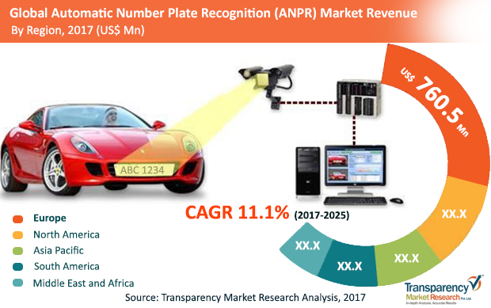
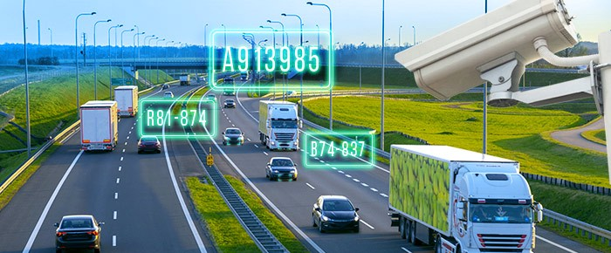
Problem Statement
To create an affordable solution through image processing of number plates of vehicles for the detection, identification and monitoring of vehicles in different scenarios such as residential societies, tolls, business complex, parking spaces etc.

Slide 4
Features
Real-time monitoring autonomous system.
Position Tracking.
Processes multiple license plates quickly and accurately in less time.
Reliable Performance, Good Accuracy with Low False Positives.
Works even with misaligned letters in the license plate.
Supports capture of License Plate along with the car image.

Slide 5
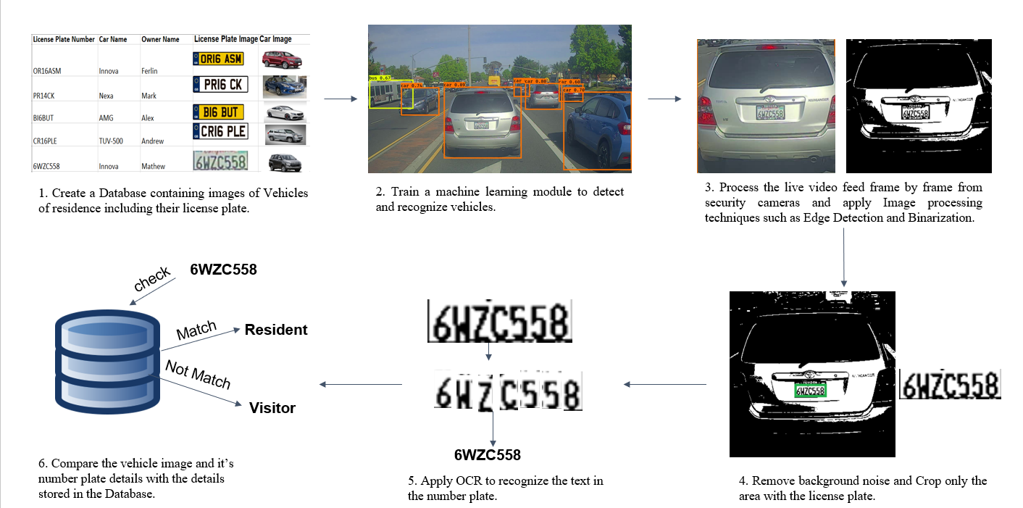
Solution Steps

Slide 6
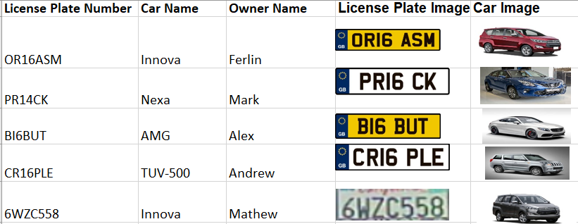
1. Create a Database containing images of vehicles of residence including their license plate number.

Slide 7
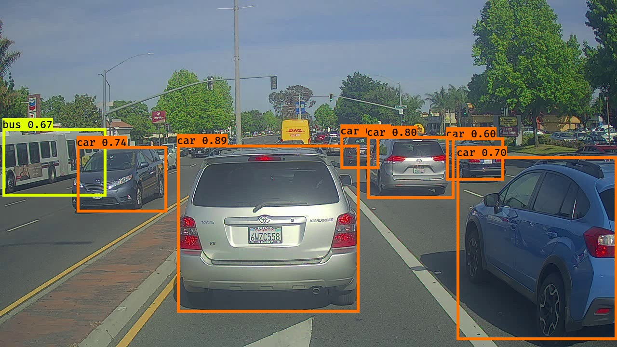
2.Train a machine learning module to detect and recognize vehicles.

Slide 8
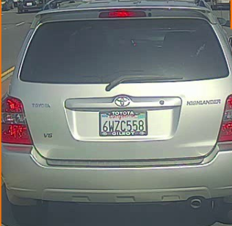
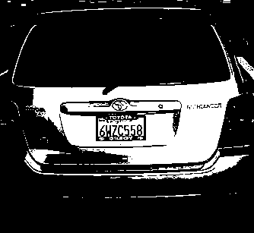
3. Process the live video feed frame by frame from security cameras and apply image processing techniques such as Edge Detection and Binarization.

Slide 9
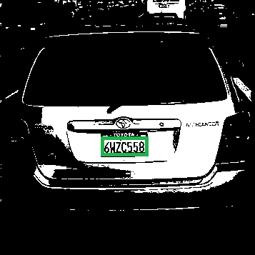
4. Remove background noise and crop only the area with the license plate.

Slide 10
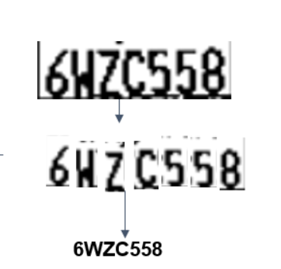
5. Apply Optical Character Recognition to recognize the text in the number plate

Slide 11
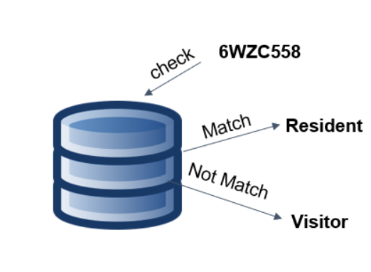
6.Compare the Vehicles image and its number plate details with the details stored in the database.

Slide 12
Applications
Automatic highway toll collection systems.
Analysis of traffic during peak periods.
Enhanced vehicle theft prevention.
Effective law enforcement.
Effective enforcement of traffic rules.

Slide 13
Thank You

